Slide 1

Capital Budgeting
Msc Corporate Financial Management
Lille Campus - 18 hours
Skema Business School
Step 2 : Remind Value Creation Investment Decision Rules
Investment Decision Rules
Pr. Sébastien DEREEPER
Sebastien.Dereeper@skema.edu
Course Based on :
J. Berk & P. De Marzo - Corporate Finance - Pearson, 2024
Notes:
If this PowerPoint presentation contains mathematical equations, you may need to check that your computer has the following installed:
1) Math Type Plugin
2) Math Player (free versions available)
3) NVDA Reader (free versions available)

Slide 2
Outline
1 N P V and Stand-Alone Projects
2 The Internal Rate of Return Rule
3 The Payback Rule
4 Choosing between Projects
5 Project Selection with Resource Constraints

Slide 3
Learning Objectives (1 of 2)
Define net present value, payback period, internal rate of return, profitability index, and incremental I R R.
Describe decision rules for each of the tools in objective 1, for both stand-alone and mutually exclusive projects.
Given cash flows, compute the N P V, payback period, internal rate of return, and profitability index for a given project, and the incremental I R R for a pair of projects.

Slide 4
Learning Objectives (2 of 2)
Compare each of the capital budgeting tools above, and tell why N P V always gives the correct decision.
Discuss the reasons I R R can give a flawed decision.
Describe situations in which profitability index cannot be used to make a decision.

Slide 5
1 N P V and Stand-Alone Projects
Consider a take-it-or-leave-it investment decision involving a single, stand-alone project for Fredrick’s Feed and Farm (F F F)
  The project costs $250 million and is expected to generate cash flows of $35 million per year, starting at the end of the first year and lasting forever

Slide 6
Applying the N P V Rule
The N P V of the project is calculated as:
  The N P V is dependent on the discount rate

Slide 7
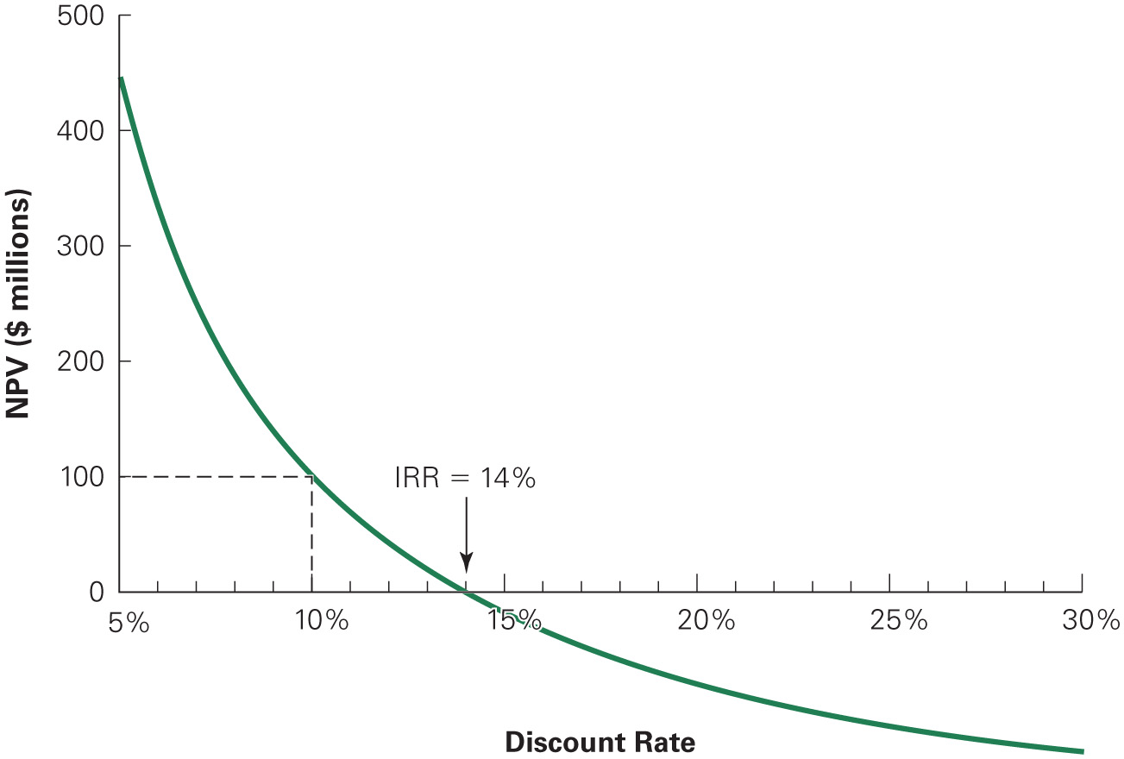
Figure 1 : NPV of Fredrick’s Fertilizer Project
If F F F’s cost of capital is 10%, the N P V is $100 million, and they should undertake the investment
Notes:
Long Description:
The x-axis shows the discount rate ranging from 5 to 30 in increments of 5 and the y-axis shows the value of N P V in dollars ranging from 0 to 500 in increments of 100. The graph is a descending curve that shows positive value of N P V for discount rates less than 14 percent and negative value for discount rates greater than 14 percent. Here, I R R equals 14 percent. The N P V values at different discount rates are as follows- 5 percent: 450, 10 percent: 100, 14 percent: 0.

Slide 8
Alternative Rules Versus the N P V Rule
Sometimes alternative investment rules may give the same answer as the N P V rule, but at other times they may disagree
  When the rules conflict, the N P V decision rule should be followed

Slide 9
2. The Internal Rate of Return Rule (1 of 2)
Internal Rate of Return (I R R) Investment Rule
  Take any investment where the I R R exceeds the cost of capital
  Turn down any investment whose I R R is less than the cost of capital

Slide 10
2. The Internal Rate of Return Rule (1 of 2)
The I R R Investment Rule will give the same answer as the N P V rule in many, but not all, situations
In general, the I R R rule works for a stand-alone project if all of the project’s negative cash flows precede its positive cash flows
  In Figure 1, whenever the cost of capital is below the I R R of 14%, the project has a positive N P V, and you should undertake the investment

Slide 11
Applying the IRR rule
In other cases, the I R R rule may disagree with the N P V rule and thus be incorrect
  Situations where the I R R rule and N P V rule may be in conflict:
    Delayed Investments
    Nonexistent I R R
    Multiple I R R s

Slide 12
Pitfall 1: Delayed Investments (1 of 3)
Assume you have just retired as the C E O of a successful company. A major publisher has offered you a book deal. The publisher will pay you $1 million upfront if you agree to write a book about your experiences.
You estimate that it will take three years to write the book. The time you spend writing will cause you to give up speaking engagements amounting to $500,000 per year. You estimate your opportunity cost to be 10%.

Slide 13
Pitfall 1: Delayed Investments (2 of 3)
Should you accept the deal?
  Calculate the I R R
Table 1
Blank | N P E R | RATE | P V | P M T | F V | Excel Formula
Given | 3 | Blank | 1,000,000 | Negative 500,000 | 0 | Blank
Solve for 1 | blank | 23.38% | Blank | Blank | Blank | Equals rate left parenthesis 3 comma 500000 comma 1000000 comma 0 right parenthesis.
  The I R R is greater than the cost of capital
  Thus, the I R R rule indicates you should accept the deal

Slide 14
Pitfall 1: Delayed Investments (3 of 3)
Should you accept the deal?
Since the N P V is negative, the N P V rule indicates you should reject the deal

Slide 15
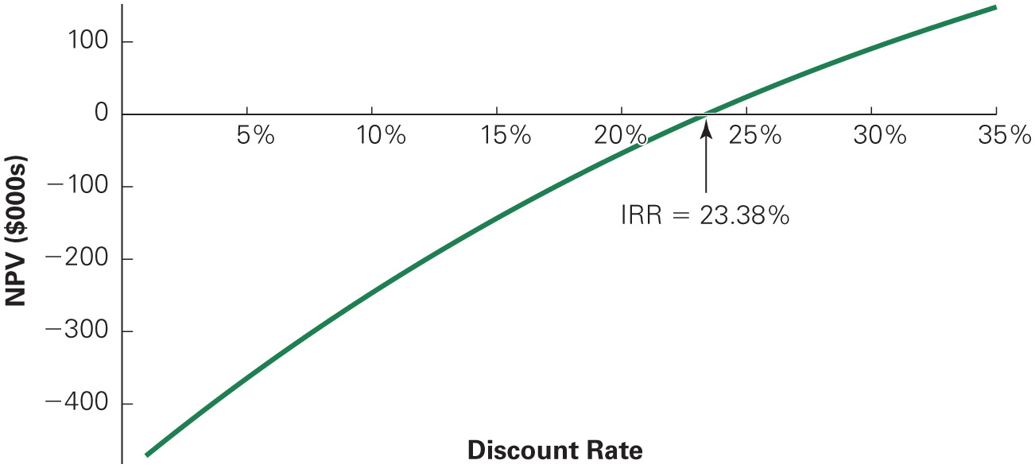
Figure 2 : NPV of Star’s $1 Million Book Deal
When the benefits of an investment occur before the costs, the NPV is an increasing function of the discount rate
Notes:
Long Description:
The x-axis shows the discount rate ranging from 0 to 35 in increments of 5 and the y-axis shows the value of N P V in dollars ranging from negative 400 to 100 in increments of 100. The graph is an ascending curve the that shows positive value of N P V for discount rates greater than 23.38 percent and negative value for discount rates less than 23.38 percent. Here, I R R equals 23.38 percent.

Slide 16
Pitfall 2: Multiple I R R s (1 of 4)
Suppose Star informs the publisher that it needs to sweeten the deal before he will accept it
The publisher offers $550,000 advance and $1,000,000 in four years when the book is published
Should he accept or reject the new offer?

Slide 17
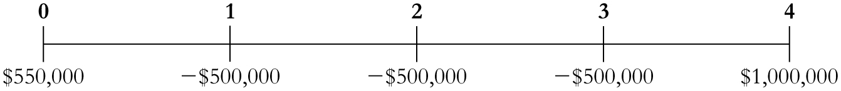
Pitfall 2: Multiple I R R s (2 of 4)
The cash flows would now look like
The N P V is calculated as
+
Notes:
Long Description:
N P V equals 550,000 minus start fraction 500,000 over 1 plus r end fraction minus start fraction 500,000 over left parenthesis 1 plus r right parenthesis superscript 2 baseline end fraction minus start fraction 500,000 over left parenthesis 1 plus r right parenthesis superscript 3 baseline end fraction minus start fraction 1,000,000 over left parenthesis 1 plus r right parenthesis superscript 4 baseline end fraction.

Slide 18
Pitfall 2: Multiple I R R s (3 of 4)
By setting the N P V equal to zero and solving for r, we find the I R R
In this case, there are two I R Rs: 7.164% and 33.673%
Because there is more than one I R R, the I R R rule cannot be applied

Slide 19
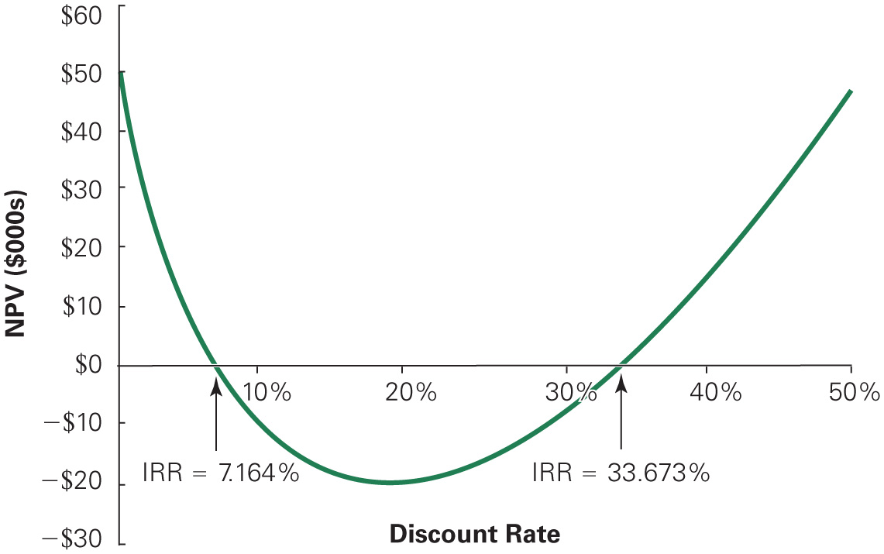
Figure 3 : NPV of Star’s Book Deal with Royalties
Notes:
Long Description:
The graph is plotted between the discount rate on the x-axis ranging from 0 to 50 in increments of 10 and N P V from negative 30 to 60 in increments of 10. The values plotted are as follows: 0 percent, 50; 10 percent: negative 10.41; 20 percent: negative 19.5; 30 percent: negative 5.93; 40 percent: 15.85; 50 percent: 47.5 percent. All data are approximate. Marked on the curve are I R R equals 7.164 percent; I R R equals 33.673 percent.

Slide 20
Pitfall 2: Multiple I R R s (4 of 4)
As seen in Figure 3, between 7.164% and 33.673%, the book deal has a negative N P V
Since your opportunity cost of capital is 10%, you should reject the deal

Slide 21
Pitfall 3: Nonexistent I R R
Finally, Star is able to get the publisher to increase his advance to $750,000, in addition to the $1 million when the book is published in four years
With these cash flows, no I R R exists; there is no discount rate that makes N P V equal to zero

Slide 22
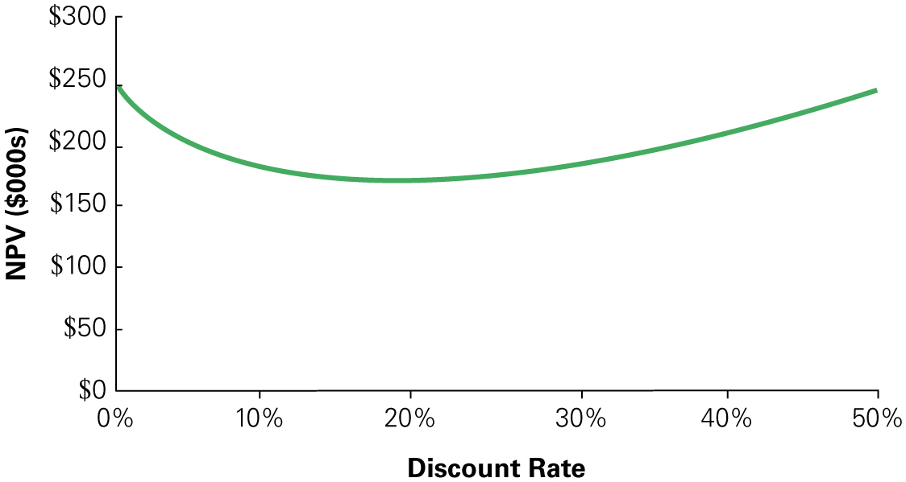
Figure 4 : N P V of Star’s Final Offer
No I R R exists because the N P V is positive for all values of the discount rate. Thus the I R R rule cannot be used
Notes:
Long Description:
The x-axis shows the discount rate ranging from 0 to 50 in increments of 10 and the y-axis shows the value of N P V in thousand dollars ranging from 0 to 300 in increments of 50. The graph is a curve that starts at (0, 250) and ends at (50, 250). The lowest point of the curve is at (18, 154).

Slide 23
Common Mistake
I R R Versus the I R R Rule
  While the I R R rule has shortcomings for making investment decisions, the I R R itself remains useful
  I R R measures the average return of the investment and the sensitivity of the N P V to any estimation error in the cost of capital

Slide 24
3. The Payback Rule (1 of 2)
The payback period is amount of time it takes to recover or pay back the initial investment
If the payback period is less than a pre-specified length of time, you accept the project
Otherwise, you reject the project
  The payback rule is used by many companies because of its simplicity

Slide 25
Frederick’s Example (1 of 2)
The Payback Rule
Problem
Assume Fredrick’s requires all projects to have a payback period of five years or less. Would the firm undertake the fertilizer project under this rule?

Slide 26
Frederick’s Example (2 of 2)
Solution
Recall that the project requires an initial investment of $250 million, and will generate $35 million per year. The sum of the cash flows from year 1 to year 5 is
million, which will not cover the initial investment of $250 million. In fact, it will not be until year 8 that the initial investment will be paid back
Because the payback period for this project exceeds five years, Fredrick’s will reject the project.

Slide 27
The Payback Rule (2 of 2)
Pitfalls
  Ignores the project’s cost of capital and time value of money
  Ignores cash flows after the payback period
  Relies on an ad hoc decision criterion

Slide 28
4 Choosing between Projects
Mutually Exclusive Projects
  When you must choose only one project among several possible projects, the choice is mutually exclusive
  N P V Rule
    Select the project with the highest N P V
  I R R Rule
    Selecting the project with the highest I R R may lead to mistakes

Slide 29
Mutually exclusive projects (1 of 2)
N P V and Mutually Exclusive Projects
Problem
A small commercial property is for sale near your university. Given its location, you believe a student – oriented business would be very successful there. You have researched several possibilities and come up with the following cash flow estimates (including the cost of purchasing the property). Which investment should you choose?
Table 2
Project | Initial Investment | First-Year Cash Flow | Growth Rate | Cost of Capital
Book store | $300,000 | $63,000 | 3.0 percent. | 8%
Coffee shop | $400,000 | $80,000 | 3.0 percent. | 8%
Music store | $400,000 | $104,000 | 0.0 percent. | 8%
Electronic store | $400,000 | $100,000 | 3.0 percent. | 11%

Slide 30
Mutually exclusive projects (2 of 2)
Solution
Assuming each business lasts indefinitely, we can compute the present value of the cash flows from each as a constant growth perpetuity. The N P V of each project is
Thus, all of the alternatives have a positive N P V. But, because we can only choose one, the coffee shop is the best alternative.

Slide 31
I R R Rule and Mutually Exclusive Investments (1 of 4)
Differences in Scale
  If a project’s size is doubled, its N P V will double
    This is not the case with I R R
  Thus, the I R R rule cannot be used to compare projects of different scales

Slide 32
I R R Rule and Mutually Exclusive Investments (2 of 4)
Differences in Scale
  Consider two of the projects from precedent Example
Table 3
Blank | Book store | Coffee shop
Initial Investment | $300,000 | $400,000
Cash flow subscript year 1 baseline. | $63,000 | $80,000
Annual Growth Rate | 3% | 3%
Cost of capital | 8% | 8%
I R R | 24% | 23%
N P V | $960,000 | $1,200,000

Slide 33
I R R Rule and Mutually Exclusive Investments (3 of 4)
Timing of Cash Flows
  Another problem with the I R R is that it can be affected by changing the timing of the cash flows, even when the scale is the same
    I R R is a return, but the dollar value of earning a given return depends on how long the return is earned
  Consider again the coffee shop and the music store investment in precedent Example
  Both have the same initial scale and the same horizon.
  The coffee shop has a lower I R R, but a higher N P V because of its higher growth rate

Slide 34
I R R Rule and Mutually Exclusive Investments (4 of 4)
Differences in Risk
  An I R R that is attractive for a safe project need not be attractive for a riskier project
  Consider the investment in the electronics store from the precedent example
  The I R R is higher than those of the other investment opportunities, yet the N P V is the lowest
  The higher cost of capital means a higher I R R is necessary to make the project attractive

Slide 35
The Incremental I R R Rule (1 of 2)
Incremental I R R Investment Rule
  Apply the I R R rule to the difference between the cash flows of the two mutually exclusive alternatives (the increment to the cash flows of one investment over the other)

Slide 36
Overhaul Example (1 of 4)
Using the Incremental I R R to Compare Alternatives
Problem
Your firm is considering overhauling its production plant. The engineering team has come up with two proposals, one for a minor overhaul and one for a major overhaul. The two options have the following cash flows(in millions of dollars):
Table 4
Proposal | 0 | 1 | 2 | 3
Major overhaul | Negative 10 | 6 | 6 | 6
Minor overhaul | negative 50 | 25 | 25 | 25
What is the I R R of each proposal? What is the incremental I R R? If the cost of capital for both of these projects is 12%, what should your firm do?

Slide 37
Overhaul Example (2 of 4)
Solution
We can compute the I R R of each proposal using the annuity calculator. For the minor overhaul, the I R R is 36.3%:
Table 5
Blank | N P E R | R A T E | P V | P M T | F V | Excel Formula
Given | 3 | Blank | Negative 10 | 6 | 0 | Blank
Solve for rate | Blank | 36.3% | Blank | Blank | Blank | Equals R A T E left parenthesis 3 comma 6 comma negative 10 comma 0 right parenthesis.
For the major overhaul, the I R R is 23.4%:
Table 6
Blank | N P E R | R A T E | P V | P M T | F V | Excel Formula
Given | 3 | Blank | Negative 50 | 25 | 0 | Blank
Solve for rate | Blank | 23.4% | Blank | Blank | Blank | Equals R A T E left parenthesis 3 comma 25 comma negative 50 comma 0 right parenthesis.

Slide 38
Overhaul Example (3 of 4)
Which project is best? Because the projects have different scales, we cannot compare their I R R s directly. To compute the incremental I R R of switching from the minor overhaul to the major overhaul, we first compute the incremental cash flows:
Table 7
Proposal | 0 | 1 | 2 | 3
Major overhaul | Negative 50 | 25 | 25 | 25
Less: Minor overhaul | Negative left parenthesis negative 10 right parenthesis | Negative 6 | Negative 6 | Negative 6
Incremental cash flow | Negative 40 | 19 | 19 | 19

Slide 39
Overhaul Example (4 of 4)
These cash flows have an I R R of
Table 8
Blank | N P E R | R A T E | P V | P M T | F V | Excel Formula
Given | 3 | Blank | negative 40 | 19 | 0 | Blank
Solve for rate | blank | 20.0 percent. | Blank | Blank | Blank | Equals R A T E left parenthesis 3 comma 19 comma negative 40 comma 0 right parenthesis.
Because the incremental I R R exceeds the 12% cost of capital, switching to the major overhaul looks attractive (i.e., its larger scale is sufficient to make up for its lower I R R). We can check this result using Figure 7.5, which shows the N P V profiles for each project. At the 12% cost of capital, the N P V of the major overhaul does indeed exceed that of the minor overhaul, despite its lower I R R. Note also that the incremental I R R determines the crossover point of the N P V profiles, the discount rate for which the best project choice switches from the major overhaul to minor one.

Slide 40
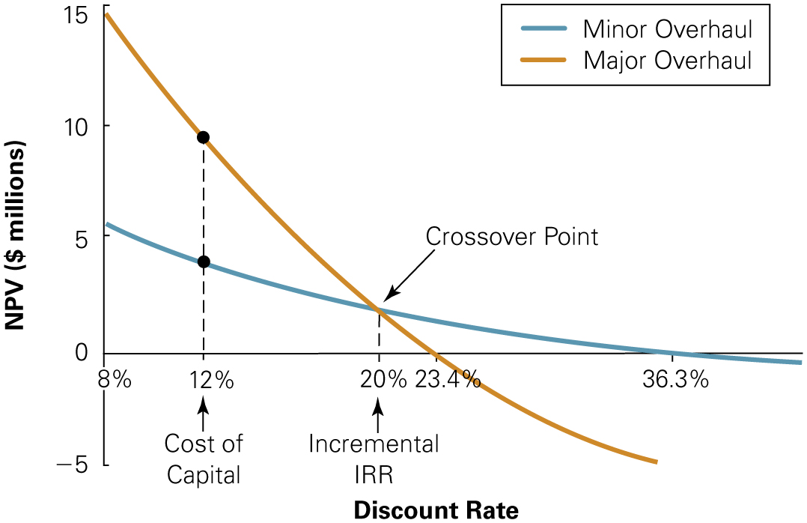
Figure 5 : Comparison of Minor and Major Overhauls
We can see that despite its lower I R R, the major overhaul has a higher N P V at the cost of capital of 12%. The incremental I R R of 20% is the crossover point at which the optimal decision changes.
Notes:
Long Description:
The x-axis shows the discount rate ranging from 8 to 36.3 varied intervals and the y-axis shows the value of N P V in million dollars ranging from 0 to 15 in increments of 5.
The plot for minor overhaul is a descending curve that starts from (8, 15) and ends at (36, minus 5). It shows positive value of N P V for discount rates less than 23.4 percent and negative value for discount rates greater than 23.4 percent. The plot for major overhaul is a descending curve that starts from (8, 5.5) and ends at around (44, minus 0.05). It shows positive value of N P V for discount rates less than 36.3 percent and negative value for discount rates greater than 36.3 percent. The point where the two plots cross (crossover point) shows an incremental IRR value of 20 percent. The cost of capital is shown as 12 percent. For plots A and C, the IRR value is 20 percent.

Slide 41
The Incremental I R R Rule (2 of 2)
Shortcomings of the Incremental I R R Rule
  The incremental I R R may not exist
  Multiple incremental I R R s could exist
  The fact that the I R R exceeds the cost of capital for both projects does not imply that either project has a positive N P V
  When individual projects have different costs of capital, it is not obvious which cost of capital the incremental I R R should be compared to

Slide 42
5. Project Selection with Resource Constraints
Evaluation of Projects with Different Resource Constraints
  Consider three possible projects with a $100 million budget constraint:
Table 9 : Possible Projects for a $100 Million Budget
Project | N P V ($ millions) | Initial Investment ($ millions) | Profitability Index N P V/ Investment
One. | 110 | 100 | 1.1
Two. | 70 | 50 | 1.4
Three. | 60 | 50 | 1.2

Slide 43
Profitability Index
The profitability index can be used to identify the optimal combination of projects to undertake
  From Table 9, we can see it is better to take projects
  and
  together and forgo project

Slide 44
NetIt Example (1 of 3)
Profitability Index with a Human Resource Constraint
Problem
Your division at NetIt, a larger networking company, has put together a project proposal to develop a new home networking router. The excepted N P V of the project is $17.7 million, and the project will require 50 software engineers. NetIt has a total of 190 engineers available, and the router project must compete with the following other projects for these engineers:
Project | N P V ($ millions) | Engineering Headcount
Router | 17.7 | 50
Project A | 22.7 | 47
Project B | 8.1 | 44
Project C | 14.0. | 40
Project D | 11.5 | 61
Project E | 20.6 | 58
Project F | 12.9 | 32
Total | 107.5 | 332
How should NetIt prioritize these projects?

Slide 45
NetIt Example (2 of 3)
Solution
The goal is to maximize the total N P V we can create with 190 engineers (at most). We compute the profitability index for each project using Engineering Headcount in the denominator, and then sort projects based on the index:
Project | N P V ($ millions) | Engineering Headcount (E H C) | Profitability Index (N P V per E H C) | Cumulative E H C Required
Project A | 22.7 | 47 | 0.483. | 47
Project F | 12.9 | 32 | 0.403. | 79
Project E | 20.6 | 58 | 0.355. | 137
Router | 17.7 | 50 | 0.354. | 187
Project C | 14.0. | 40 | 0.350. | Blank
Project D | 11.5 | 61 | 0.189. | Blank
Project B | 8.1 | 44 | 0.184. | Blank

Slide 46
NetIt Example (3 of 3)
We now assign the resource to the projects in descending order according to the profitability index. The final column shows the cumulative use of the resource as each project is taken on until the resource is used up. To maximize N P V within the constraint of 190 engineers. NetIt should choose the first four projects on the list. There is no other combination of projects that will create more value without using more engineers than we have. Note, however, that the resource constraint forces NetIt to forgo three otherwise valuable projects (C, D, and B) with a total N P V of $3.36 million.

Slide 47
Shortcomings of the Profitability Index (1 of 2)
In some situations, the profitability Index does not give an accurate answer
  Suppose in that NetIt has an additional small project with a N P V of only $120,000 that requires three engineers
  The profitability index in this case is
  so this project would appear at the bottom of the ranking
  However, three of the 190 employees are not being used after the first four projects are selected
  As a result, it would make sense to take on this project even though it would be ranked last

Slide 48
Shortcomings of the Profitability Index (2 of 2)
With multiple resource constraints, the profitability index can break down completely

Slide 49
Chapter Quiz
Explain the N P V rule for stand-alone projects.
If the I R R rule and the N P V rule lead to different decisions for a stand-alone project, which should you follow? Why?
For mutually exclusive projects, explain why picking one project over another because it has a larger I R R can lead to mistakes.
Explain why ranking projects according to their N P V might not be optimal when you evaluate projects with different resource requirements.
How can the profitability index be used to identify attractive projects when there are resource constraints?

